Slide 1
Fine-tuning the ResNet-based large human face feature extractor by Siamese Network
Presenter: Sheng-Hsing Hsiao
Advisor: Jyh-Shing Roger Jang
Dept. of CSIE, National Taiwan University, Taiwan

Slide 2
Outline
Introduction
Related Work
Method
Experiments
Conclusion
References
Notes:
不要全部大寫

Slide 3
Introduction
Faces, a basic attribute that can distinguish one person to another. There are many well-known face recognition models have deployed on modern computer vision and multimedia applications.
In real world, the face recognition models need to meet the actual cases to identify the low-resolution human faces. It is essential to explore how to achieve an efficient method without losing too much on recognition accuracy.
To address this problem, we proposed a model reconstructing the high-resolution faces before recognition. In addition, we used FaceBoxes to detection faces and VGGFace with Resnet50 backbone as the face feature extractor can run 14 FPS on NVIDIA Quadro GV100 GPU.
Notes:
不要寫全部

Slide 4
Related Work
https://arxiv.org/pdf/1811.09998.pdf

Slide 5
Related Work
https://arxiv.org/pdf/1711.10703.pdf

Slide 6
Related Work
https://arxiv.org/pdf/1711.10703.pdf

Slide 7
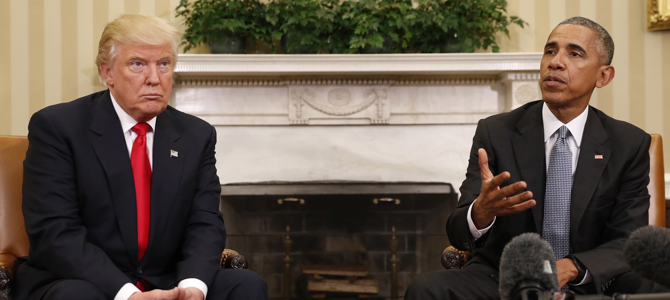
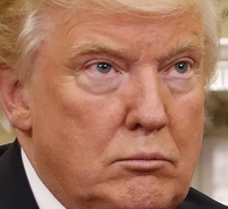
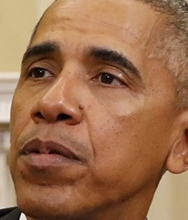
Method
System flowchart
Input image
Face Detection
Face Alignment
Aligned Faces
Face Recognition
Donald Trump
Barack Obama

Slide 8
Method
Face Recognition flowchart
Measure similarity
Face Feature Extractor
Pass the
threshold
Barack Obama
Input image
Face representations
Below the
threshold
Intruder
Notes:
第一個自大寫

Slide 9
Method
Face Detection
Faceboxes: A CPU real-time face detector with high accuracy
https://arxiv.org/pdf/1708.05234
Notes:
Rapidly Digested Convolutional Layers 主要是解決速度問題
快速的縮小feature map的大小
採用C.ReLU activation function
使用CRelU來保證輸出維度不變的情況下，減少卷積核數量
Multiple Scale Convolutional Layers(MSCL)
類似於SSD，在網絡的不同層進行檢測
作者提出來的點就在於增加小的anchor的訓練
定義了anchor 密度 來平衡對密度不足的anchor來增加偏移訓練

Slide 10
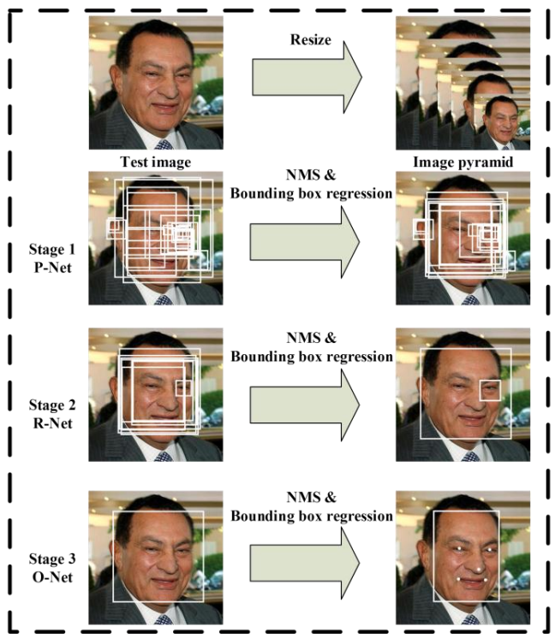
Method
MTCNN: Joint Face Detection and Alignment using Multi-task Cascaded Convolutional Networks
https://arxiv.org/abs/1604.02878
Notes:
在2016年提出的一個multi-task 論文的人臉偵測還有人臉特徵同時進行
給定一張照片的時候，將其縮放到不同尺度形成圖像金字塔，以達到尺度不變
總共有三個CNN cascade
3個stage對人臉的處理是按照一種由粗到細的方式
pnet是一個全卷積網絡(FCN)，全卷積網絡的優點在於可以輸入任意尺寸的圖像，生成人臉分類、一些bounding box、還有人臉上的landmark
使用Bounding box regression的方法來校正這些候選窗
使用非極大值抑制（NMS）合併重疊的候選框

Slide 11
Experiments
Experimental Settings
OS: Ubuntu 16.04
CPU: Intel(R) Xeon(R) CPU E5-2630 v4 @ 2.20GHz
GPU: GeForce GTX 1080 Ti
Memory: 128GB
Code language: Python 3.6.7

Slide 12
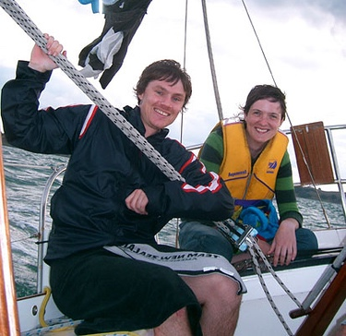
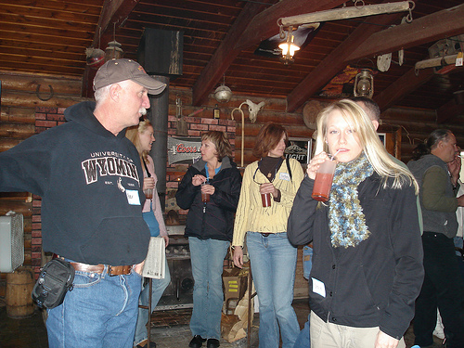
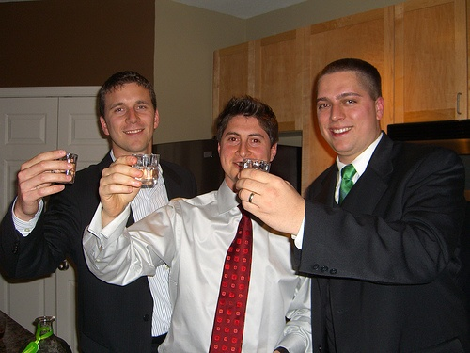
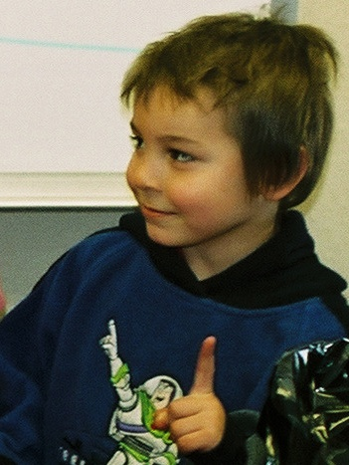
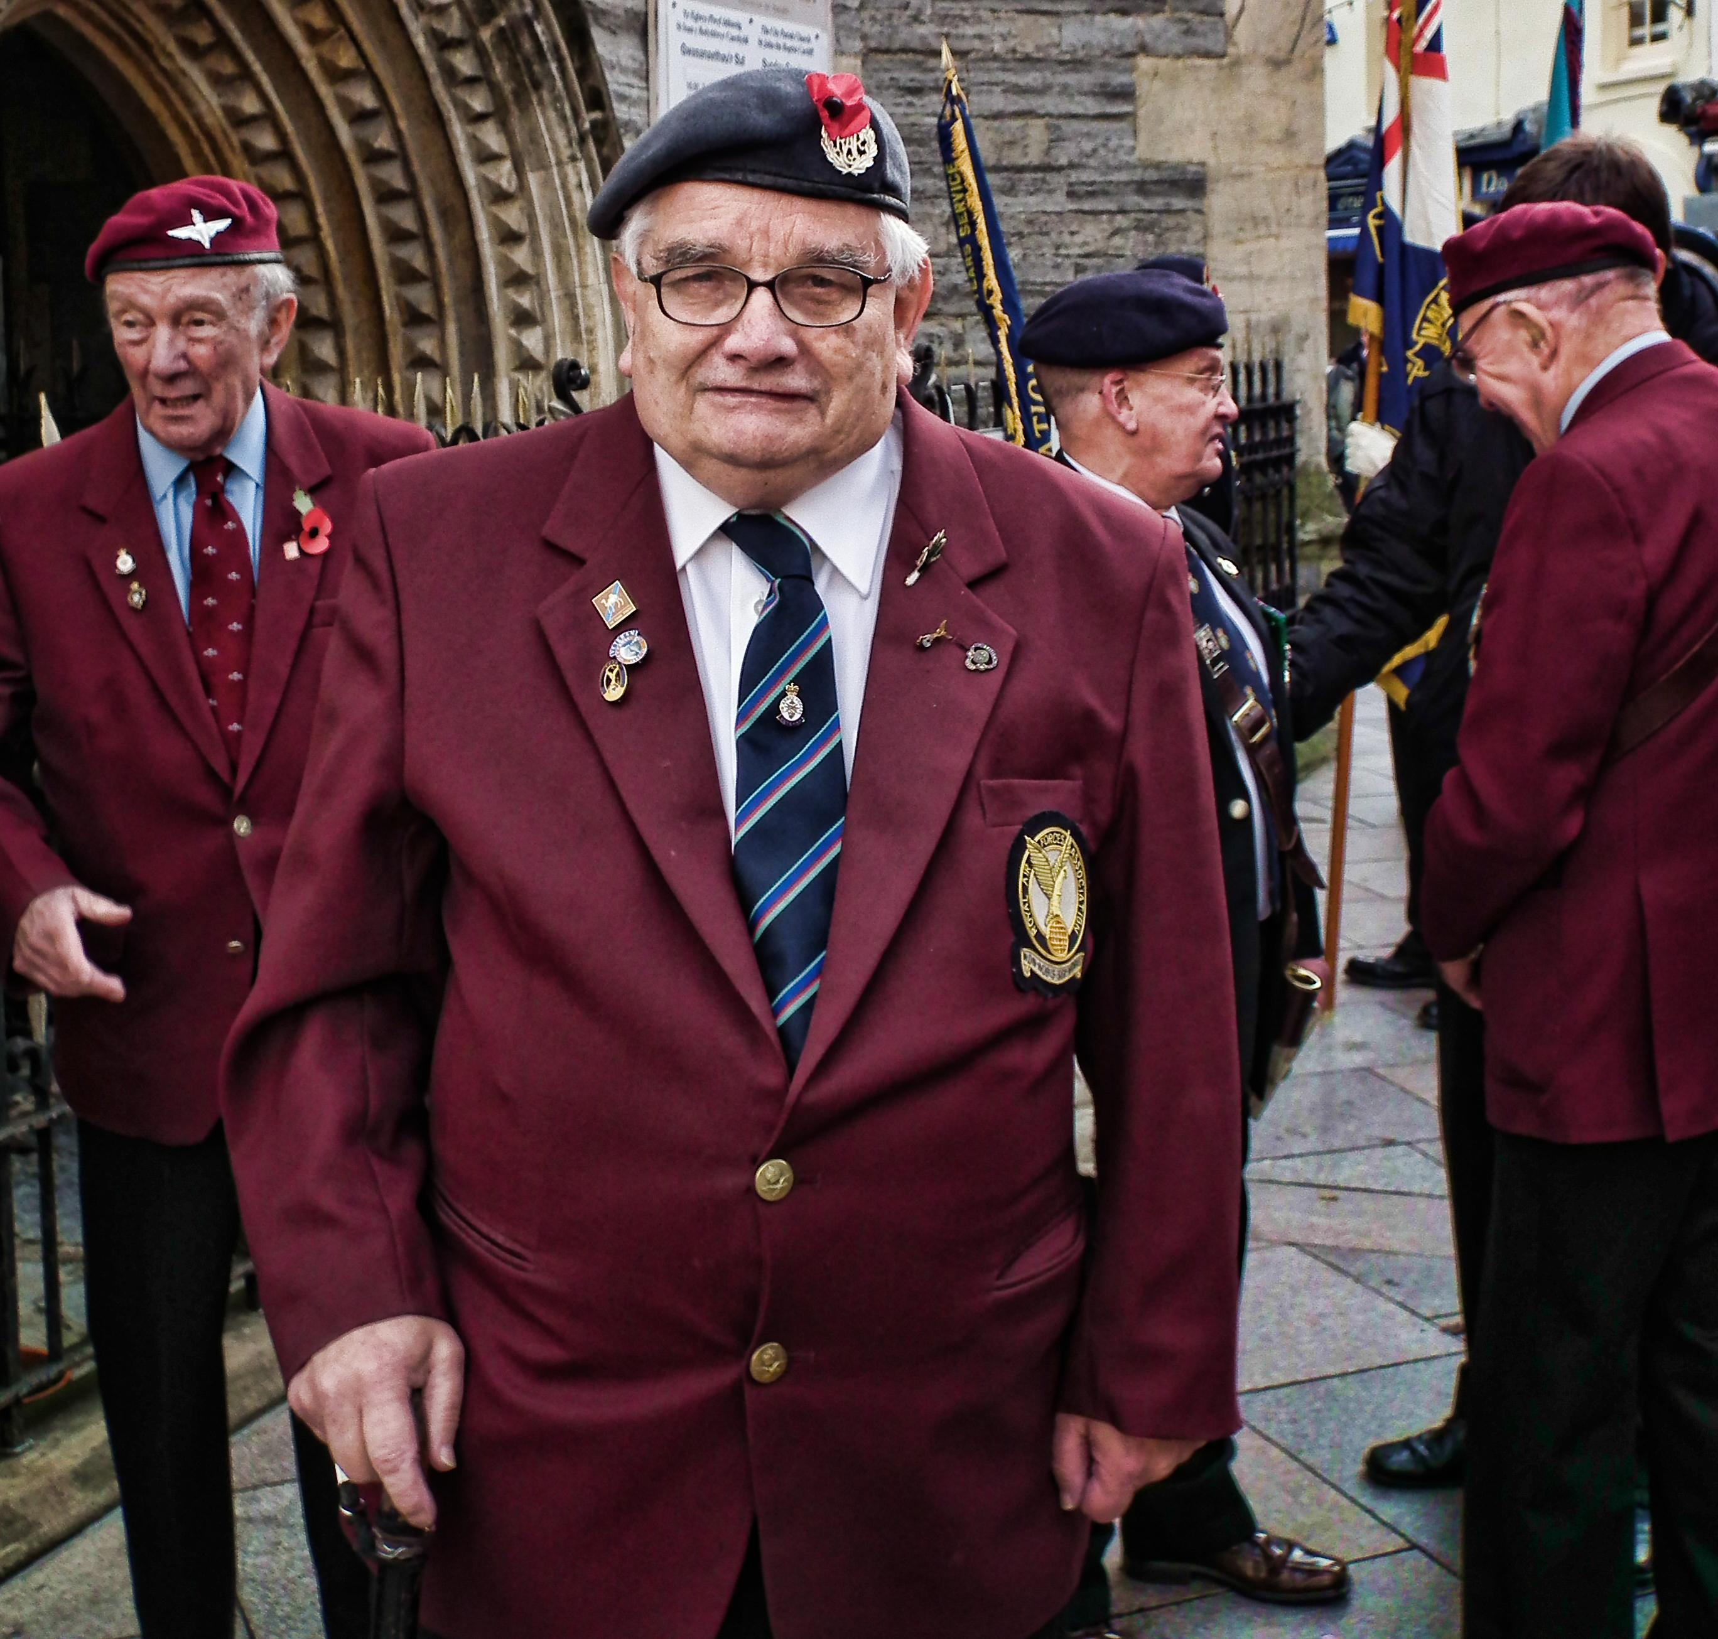
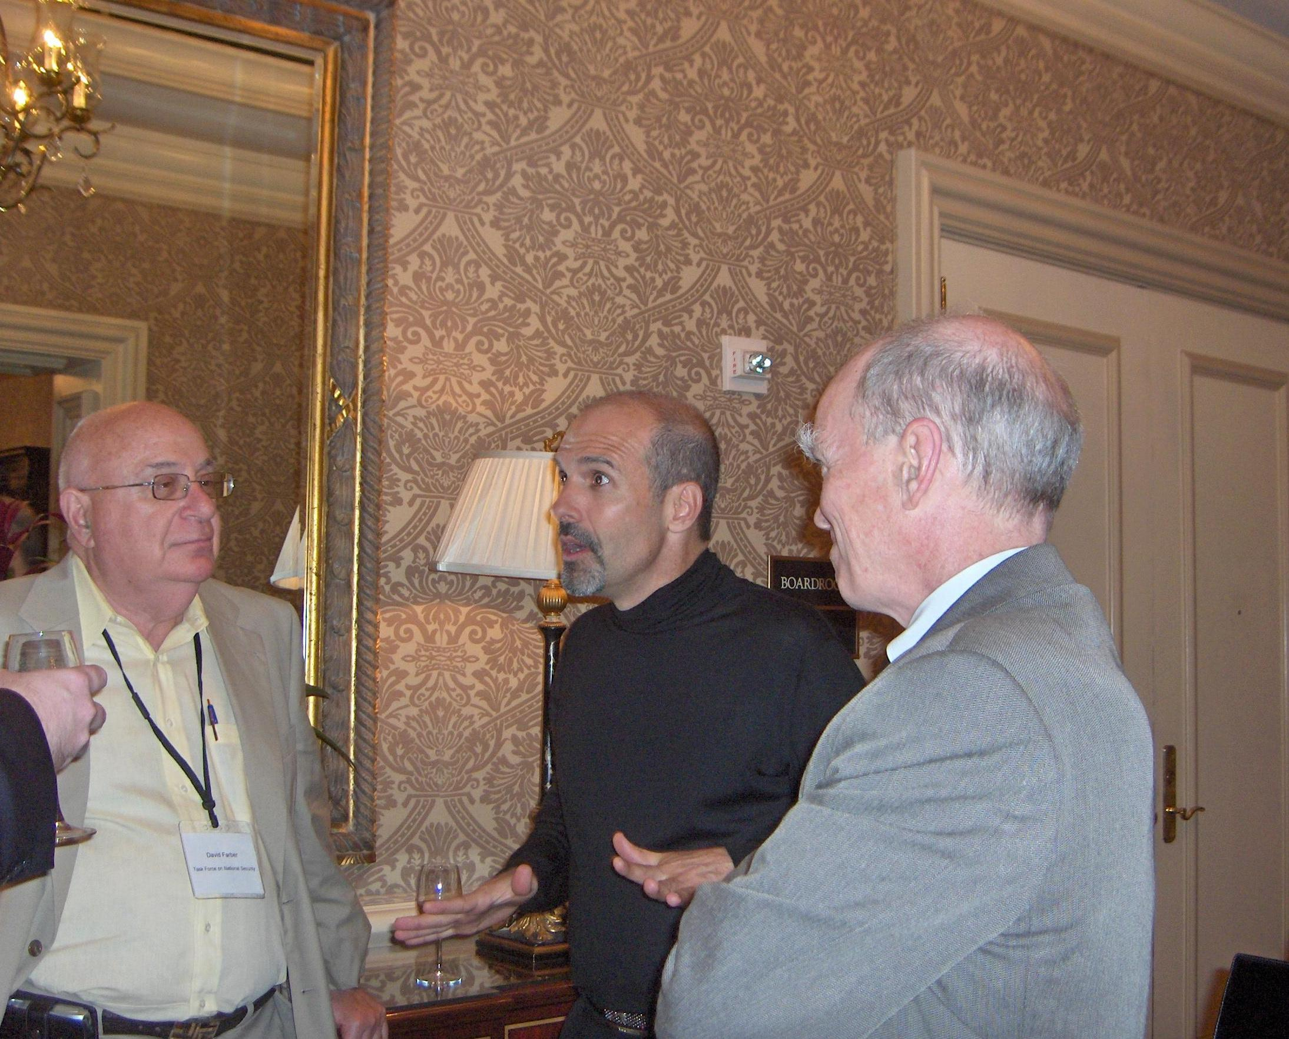
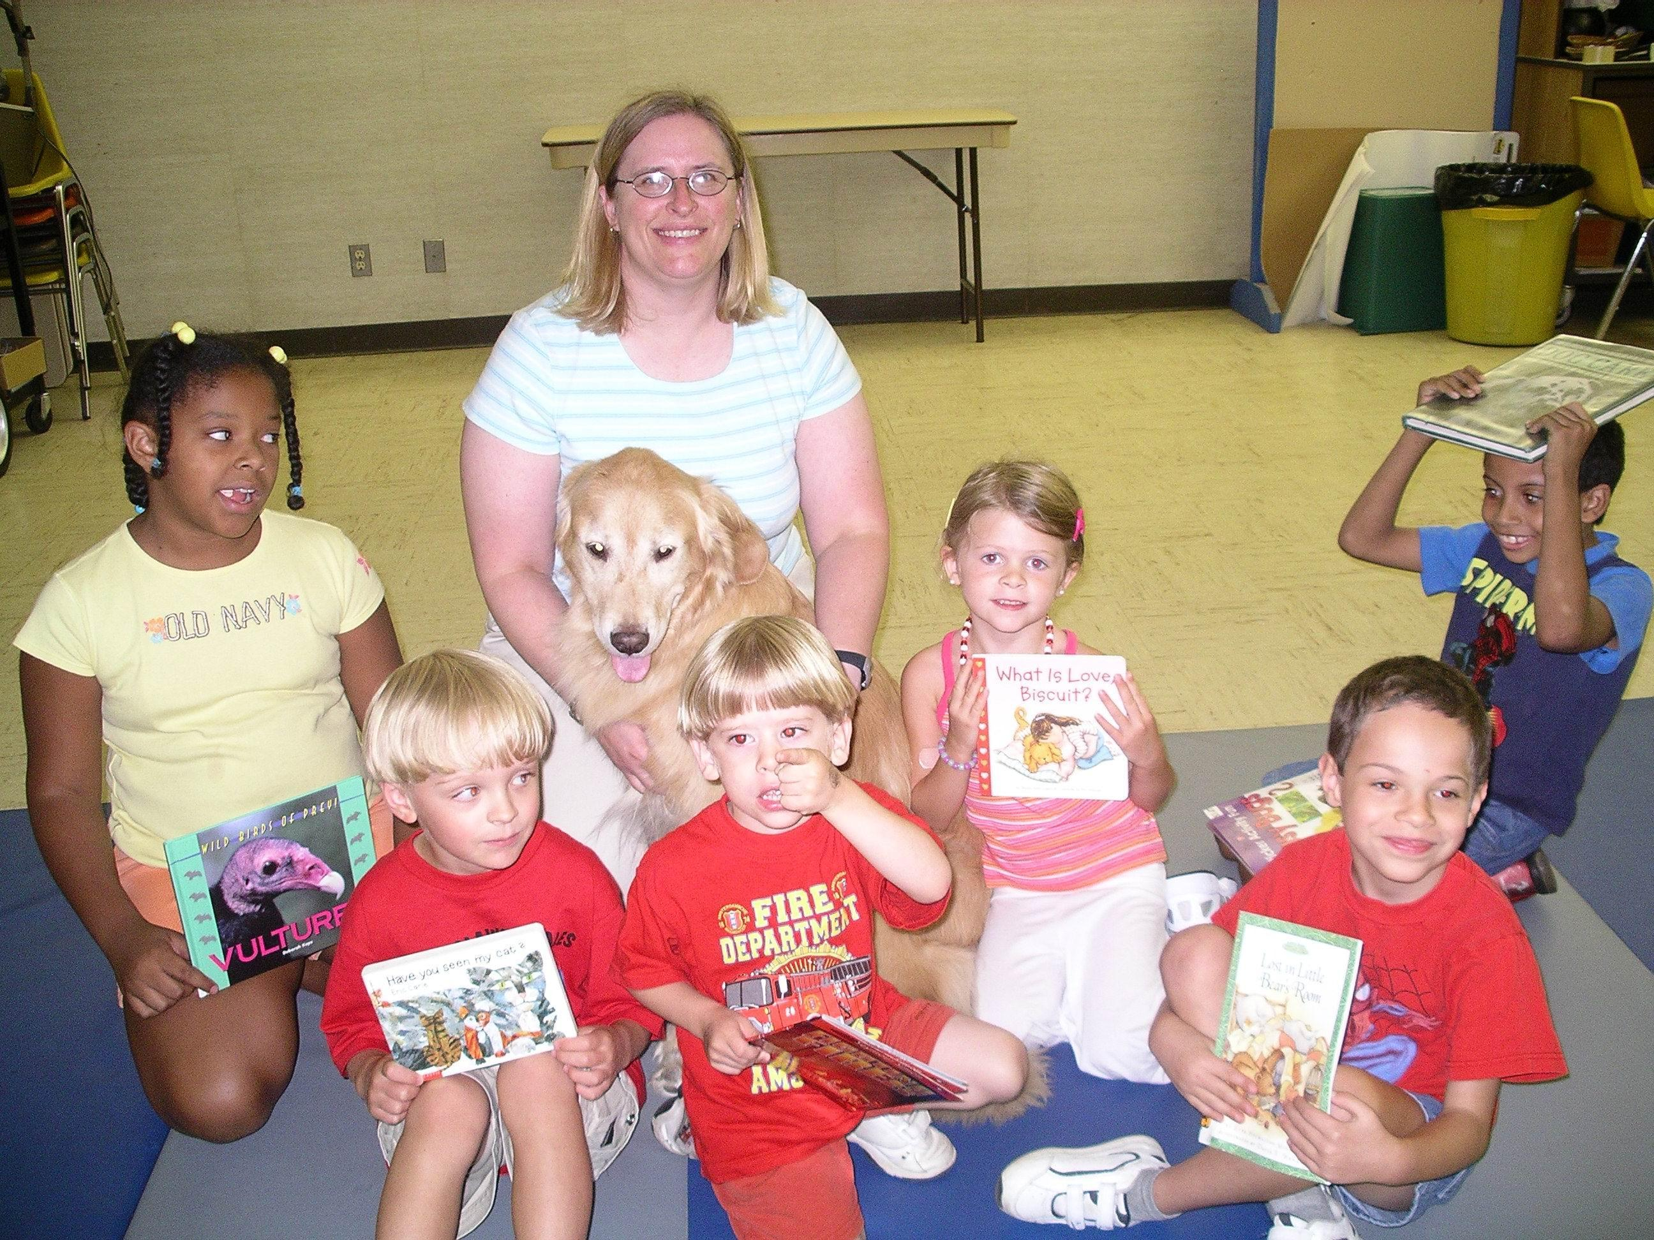
Experiments of Face Detection
Evaluate face detection performance
Datasets
PASCAL face
1335 faces from 851 images
Some examples:
AFW
205 images with 473 labeled faces
Some examples
Notes:
要有混淆矩陣

Slide 13
Experiments of Face Detection (cont.)
Evaluate face detection performance
Datasets
FDDB
5,171 faces in 2,845 images
Evaluate on discontinuous ROC curves
Provide bounding ellipse
Data-preprocessing: convert the ellipses to minimum bounding rectangles
bounding ellipse
Notes:
要有混淆矩陣

Slide 14
Experiments of Face Detection (cont.)
Evaluate face detection performance
Intersection over Union (IOU)
An Intersection over Union score > 0.5 is normally considered a “good” prediction. Depending on the metric, threshold usually be set to 50%, 75% or 95%.
True Positive (TP): A correct detection. Detection with IOU ≥ threshold
False Positive (FP): A wrong detection. Detection with IOU < threshold
False Negative (FN): A ground truth not detected
True Negative (TN): Does not apply.

Slide 15
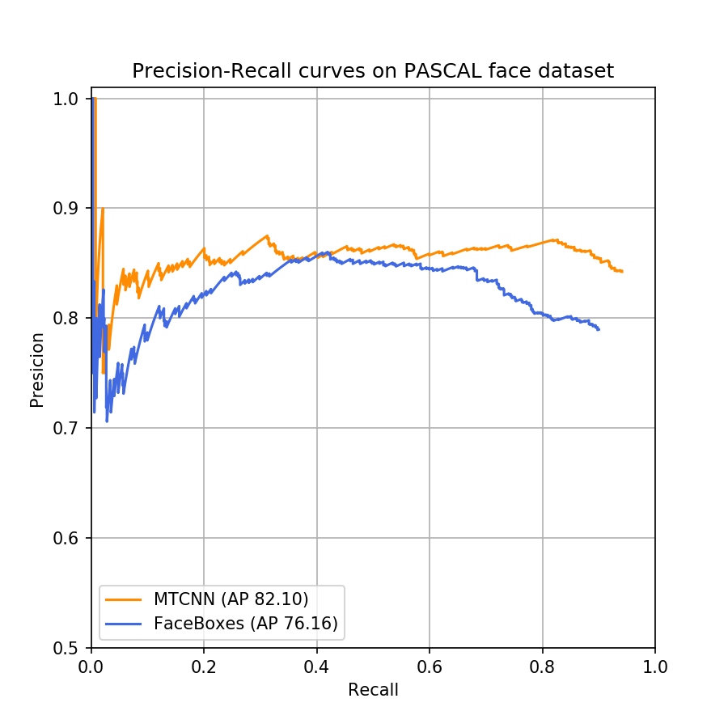
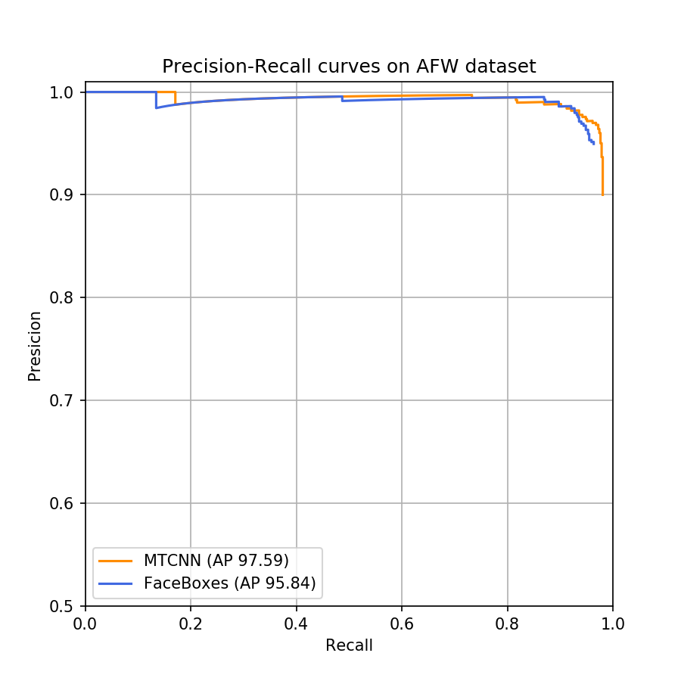
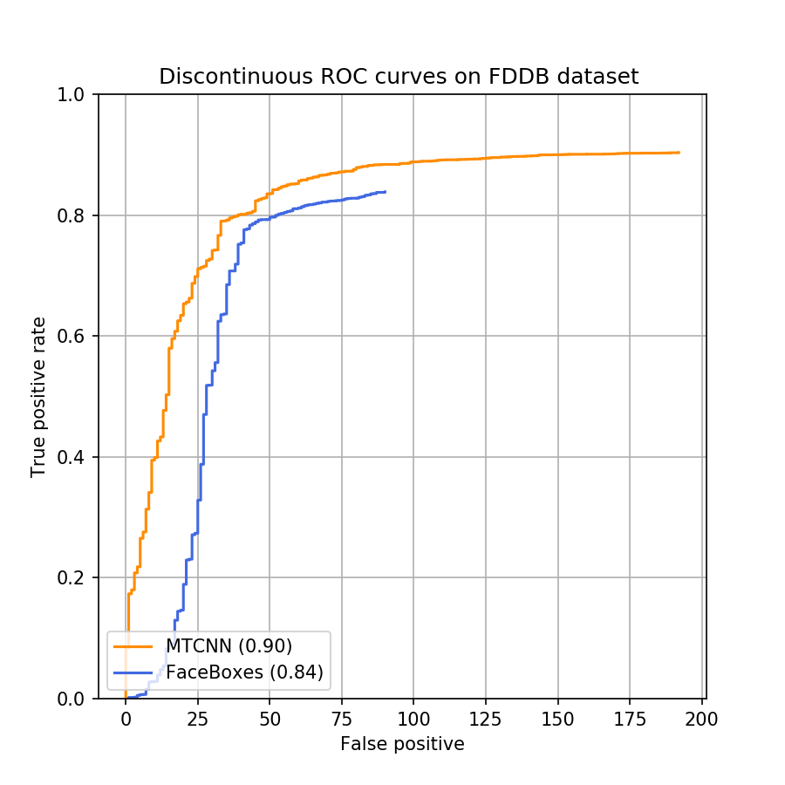
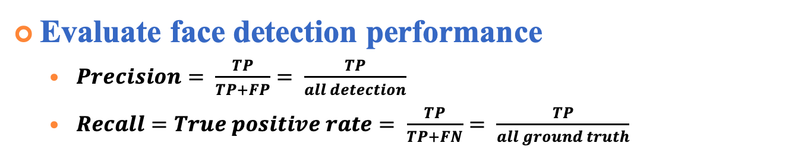
Experiments of Face Detection (cont.)
Evaluate face detection performance
$Precision= \frac{TP}{TP+FP}= \frac{TP}{all detection}$
$Recall=True positive rate= \frac{TP}{TP+FN}= \frac{TP}{all ground truth}$
PASCAL face dataset
AFW dataset
FDDB dataset
Notes:
An object detector of a particular class is considered good if its precision stays high as recall increases, which means that if you vary the confidence threshold, the precision and recall will still be high.

Slide 16
Experiments of Face Detection (cont.)
Evaluate face detection runtime efficiency
Dataset
UTKFace
Large-scale face dataset and only single face in one image
mAP(%) Approach | UTKFace | FPS
MTCNN | 94.4% | 8.86
FaceBoxes | 89.3% | 42.91
https://susanqq.github.io/UTKFace/
Notes:
An object detector of a particular class is considered good if its precision stays high as recall increases, which means that if you vary the confidence threshold, the precision and recall will still be high.

Slide 17
Experiments of Face Verification
Face verification dataset: LFW face dataset
13233 images, 5749 people, 1680 of the people pictured have two or more distinct photos.
Provide 10-fold cross validation sets.
Methods
300 matched pairs and 300 mismatched pairs within each set.
Plot ROC curve via calculating the cosine similarity.
Measure the accuracy by choosing the threshold with 10-fold validation sets.
Notes:
Labeled Faces in the Wild
http://vis-www.cs.umass.edu/lfw/index.html

Slide 18
Experiments of Face Verification (cont.)
Evaluate Face Recognition on LFW
Accuracy | LFW
VGG 16 | 95.33%
Resnet50 | 99.18%
Notes:
寫清楚stage
有 10 fold 每個fold都有自己的fpr/tpr 曲平均可以畫出平均的roc curve
10 個Auc的標準差代表一個標準差是0.001
標準差 根據fold/accu

Slide 19
Experiments of Face Verification (cont.)
Authorized users Dataset
CASIA-FaceV5
2,500 color facial images of 500 subject, each has 5 images
For each user, 4 images for building user vector, 1 image for the test
All face images are 16 bit color BMP files and the image resolution is 640*480
http://biometrics.idealtest.org/dbDetailForUser.do?id=9
Notes:
http://biometrics.idealtest.org/dbDetailForUser.do?id=9

Slide 20
Experiments of Face Verification (cont.)
Intruders Dataset
Helen dataset
2000 images as the outside test set
If there are multiple faces in the picture, select the one closest the image center as the test face.
http://www.ifp.illinois.edu/~vuongle2/helen/

Slide 21
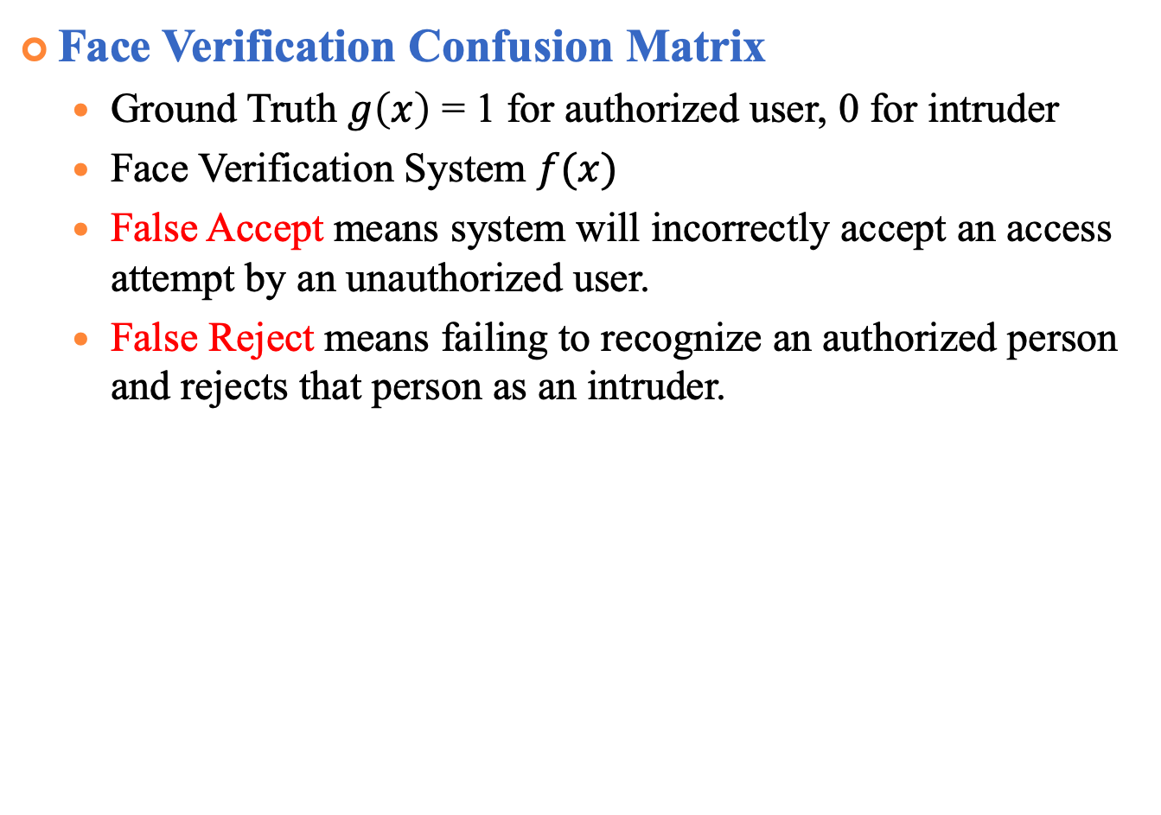
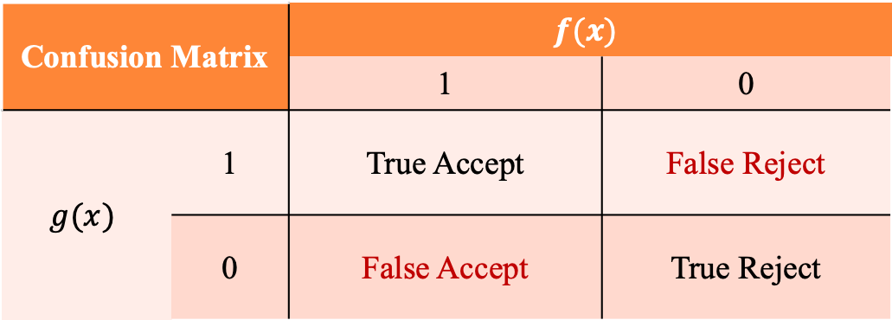
Experiments of Face Verification (cont.)
Face Verification Confusion Matrix
Ground Truth $g\left(x\right)$ = 1 for authorized user, 0 for intruder
Face Verification System $f(x)$
False Accept means system will incorrectly accept an access attempt by an unauthorized user.
False Reject means failing to recognize an authorized person and rejects that person as an intruder.
Confusion Matrix |  | $$f(x)$$
 |  | 1 | 0
$$g(x)$$ | 1 | True Accept | False Reject
 | 0 | False Accept | True Reject
Notes:
http://www.mecs-press.org/ijigsp/ijigsp-v6-n2/IJIGSP-V6-N2-6.pdf

Slide 22
Experiments of Face Verification (cont.)
Face Verification DET curve

Slide 23
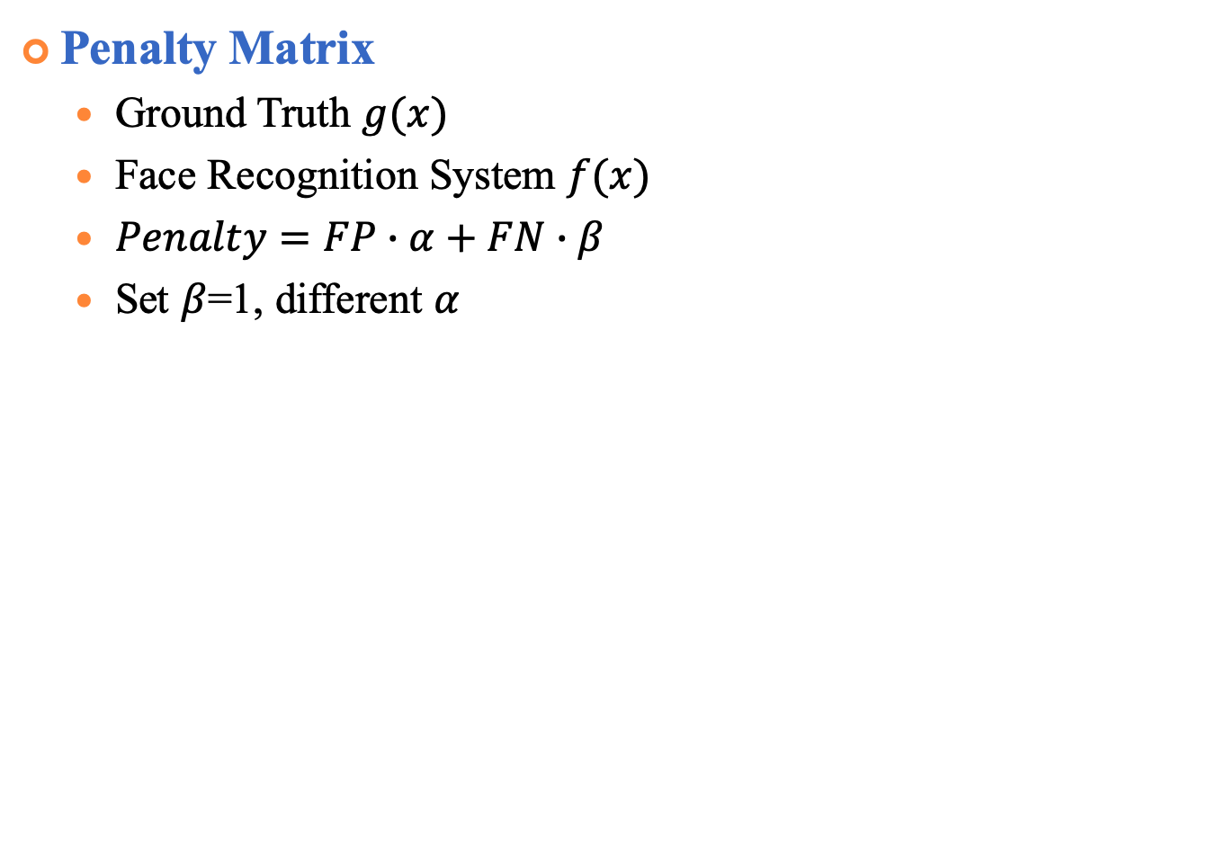
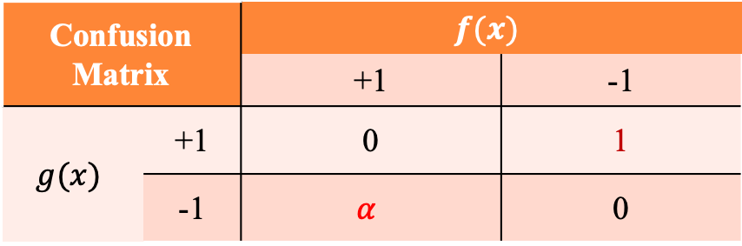
Experiments of Face Verification (cont.)
Penalty Matrix
Ground Truth $g(x)$
Face Recognition System $f(x)$
$Penalty=FP∙α+FN∙β$
Set $β$=1, different $α$
Confusion Matrix |  | $$f(x)$$
 |  | +1 | -1
$$g(x)$$ | +1 | 0 | 1
 | -1 | $$α$$ | 0

Slide 24
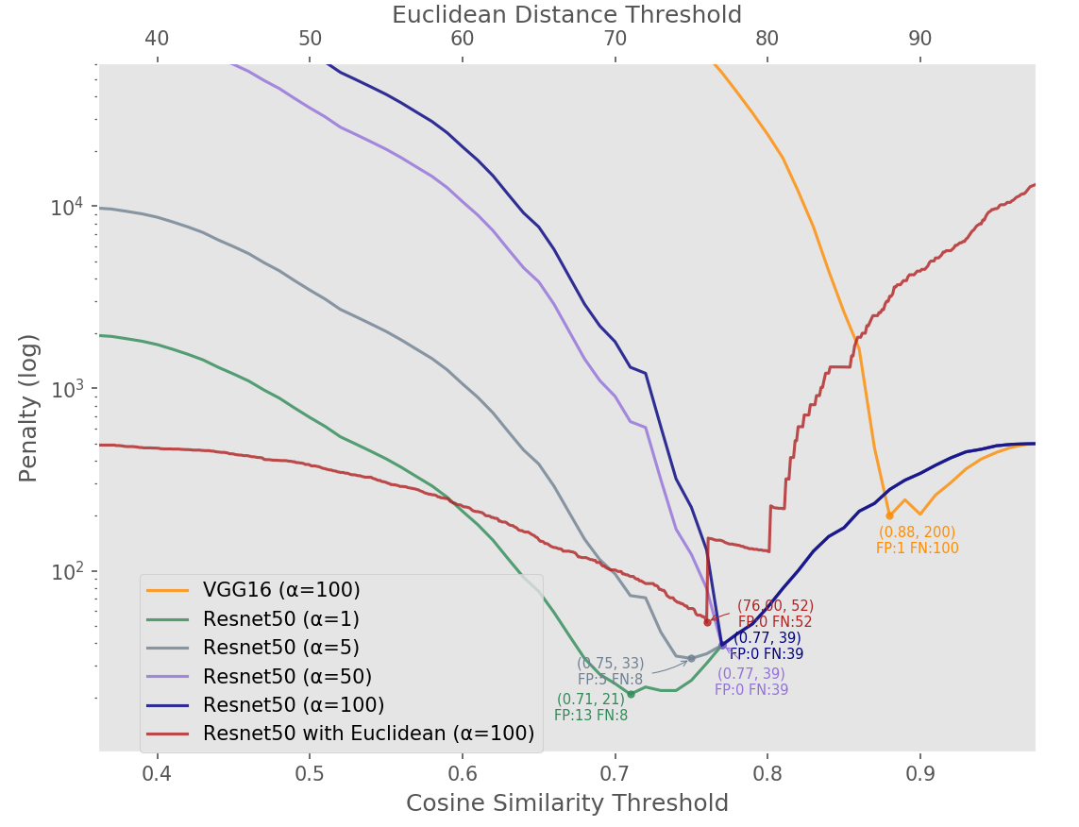
Experiments of Face Verification (cont.)
Face Verification Penalty curve

Slide 25
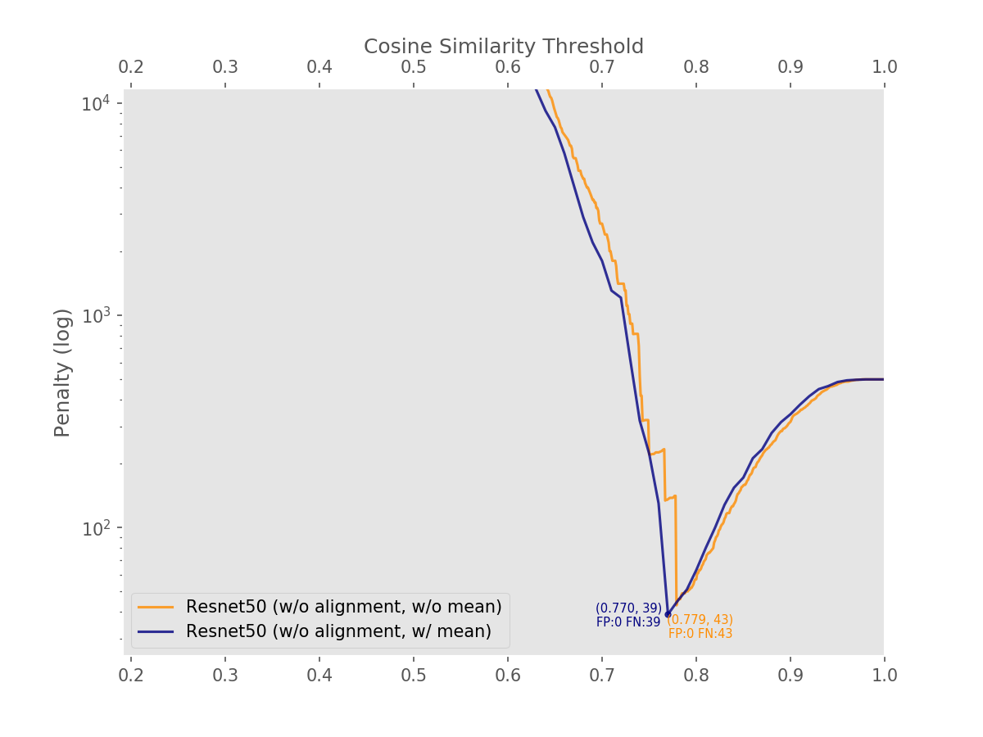
Experiments of Face Verification (cont.)
Compare single feature and mean feature
Notes:
字放大

Slide 26
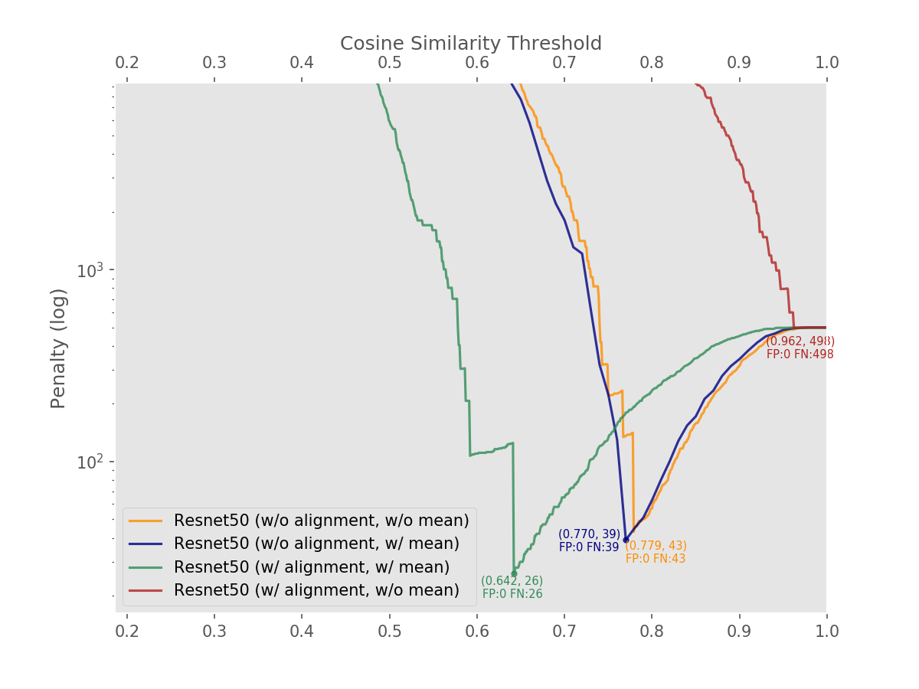
Experiments of Face Verification (cont.)
Compare the effect of alignment
Notes:
effect

Slide 27
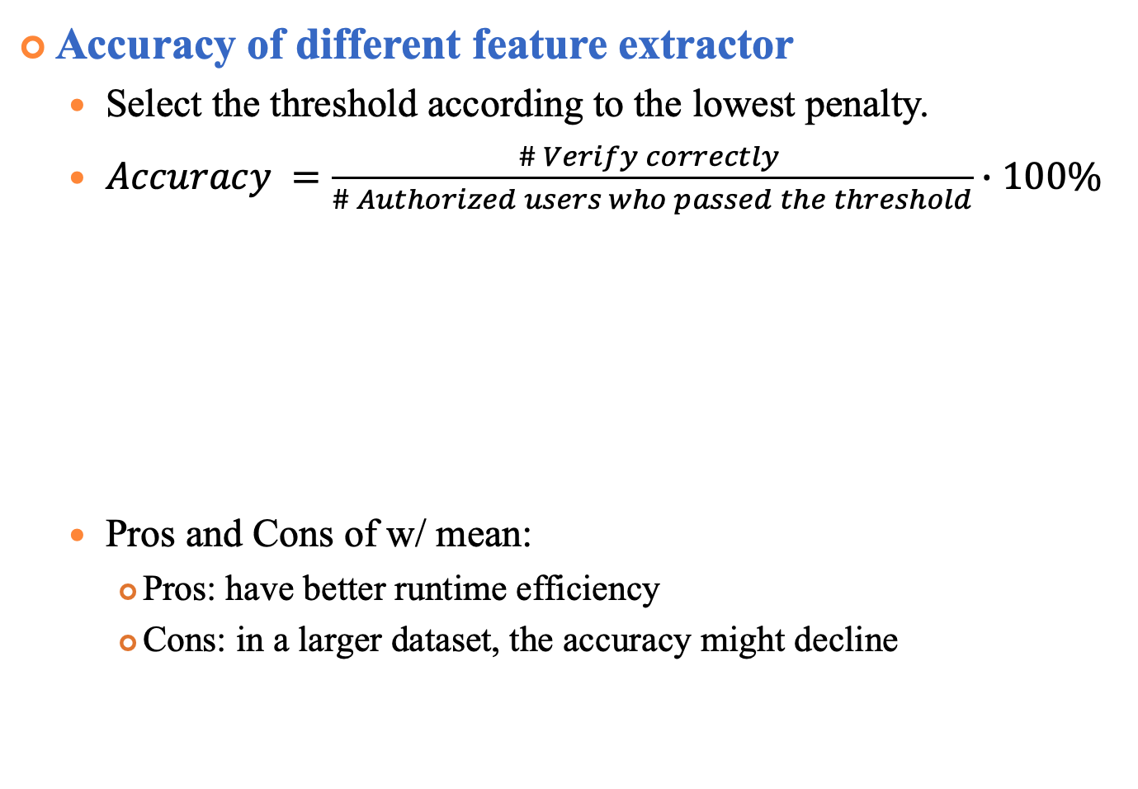
Experiments of Face Verification (cont.)
Accuracy of different feature extractor
Select the threshold according to the lowest penalty.
$Accuracy =\frac{\# Verify correctly }{\# Authorized users who passed the threshold}∙100\%$
Pros and Cons of w/ mean:
Pros: have better runtime efficiency
Cons: in a larger dataset, the accuracy might decline
Accuracy | w/ mean | w/o mean
w/ alignment | 85.65% | *100.00%
w/o alignment | 99.783% | 99.781%
only two authorized users pass the threshold
and both verified correctly
Notes:
實驗標題寫清楚 recongnition
全部單獨做5-fold preproceing 優缺點

Slide 28
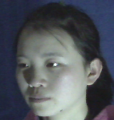
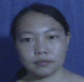
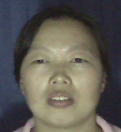
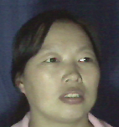
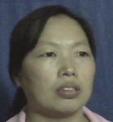
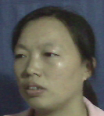
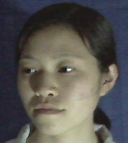
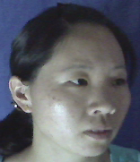
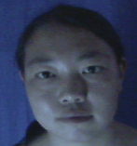
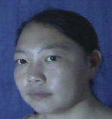
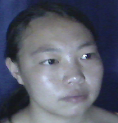
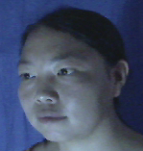
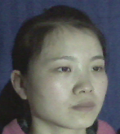
Experiments of Face Verification (cont.)
Error image (before preprocessing)
w/o mean
w/ mean
(#251)
(#118)
Closest (#115_3)
Similarity: 0.787963
Closest (#139)
Similarity: 0.806780
#2 Closest (#419_0)
Similarity: 0.757704
Second Closest (GT)
Similarity: 0.800584
#3 Closest (#118_4)
Similarity: 0.748373
Notes:
有曲各自的錯誤分析 喂進去model的圖長怎樣
在nomean錯的唯一一張，在mean中是對的但是第二名就是在nomean中第一名的
然而在mean中判斷成139這個人 在nomean中是第三名

Slide 29
Experiments of Face Verification (cont.)
Error image (after preprocessing)
w/o mean
w/ mean
(#251)
(#118)
Closest (#115_3)
Similarity: 0.787963
Closest (#139)
Similarity: 0.806780
#2 Closest (#419_0)
Similarity: 0.757704
Second Closest (GT)
Similarity: 0.800584
#3 Closest (#118_4)
Similarity: 0.748373
Notes:
Preprocessing cosine都會比較高
Preprocessing做了什麼事要講

Slide 30
Experiments of Face Verification (cont.)
Siamese Network Architecture
Notes:
用不同dataset來算benchmark

Slide 31
Experiments of Face Verification (cont.)
Siamese Network Architecture
Loss function: Contrastive Loss
Yann LeCun ’06 Dimensionality Reduction by Learning an Invariant Mapping
Notes:
Yann LeCun的Dimensionality Reduction by Learning an Invariant Mapping
D兩個樣本特徵的歐氏距離
y為兩個樣本是否匹配的標籤，y=1代表兩個樣本相似或者匹配，y=0則代表不匹配，alpha為設定的閾值。
主要是用在降維中，即本來相似的樣本，在經過降維（特徵提取）後，在特徵空間中，兩個樣本仍舊相似；而原本不相似的樣本，在經過降維後，在特徵空間中，兩個樣本仍舊不相似。

Slide 32
Experiments
Siamese Network Dataset: VGGFace2 (A large scale image dataset for face recognition)
9,000 + identities
3.3 million + faces
Average 362 samples per-subject
VGGFace2: A dataset for recognizing face across pose and age
Notes:
http://www.robots.ox.ac.uk/~vgg/publications/2018/Cao18/cao18.pdf

Slide 33
Experiments
Siamese Network Result
Notes:
http://www.robots.ox.ac.uk/~vgg/publications/2018/Cao18/cao18.pdf 前面的人方法要敘述清楚 把training val 畫出來

Slide 34
Experiments
Siamese Network Result
Accuracy
Loss
steps

Slide 35
Conclusion

Slide 36
Thank you for your attention

Slide 37
Experiments
Super-Resolution
WDSR (Wide Activation for Efficient and Accurate Image Super-Resolution, CVPR Workshop 2018)

Slide 38
Experiments
Downscale the high-resolution images

Slide 39
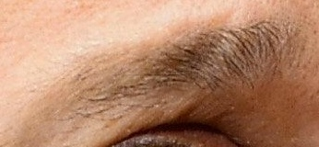
Experiments
Result of the WDSR on VGGFace2
HR
Bicubic X4
WDSR X4
HR

Slide 40
Experiments
Results of Bicubic and Super-resolution
HR
Bicubic4x
Divided4x
SR4x

Slide 41
Experiments
Results of Bicubic and Super-Resolution on LFW

